Slide 1
Computation and Analysis on Reinhardt Polygons with Multiple Prime Divisors
Molly Feldman, Robert Kenyon, Jiahui Liu
Summer@ICERM 2014

Slide 2
Reinhardt Polygons
is a convex polygon in the plane with sides
has four relevant properties
Area
Perimeter
Diameter
Width
There are 3 extremal problems
Reinhardt polygons are optimal in all three problems

Slide 3
Reinhardt Polygons (cont.)
Polynomial:
Coefficient array:
Polygon
Composition:

Slide 4
Representations
Polygons
Must have a “star” cycle in it’s center (shown in blue)
Each angle in the star can be represented as a multiple of the angle
All diameters cross one another
Notes:
Helpful uses: concrete and aesthetically pleasing

Slide 5
Representations (cont.)
Polynomials
is divisible by
has alternating sign and all coefficients are elements of
has an odd number of nonzero coefficient
In most cases, we restrict
Notes:
Helpful uses: mathematically and computationally easiest to work with, in polynomial form for theory and in coefficient array form for computation

Slide 6
Representations (cont.)
Compositions
Composition of is a sequence of positive integers whose sum is
We represent a Reinhardt polynomial as a composition of the number of “gaps” between nonzero terms
Must always have an odd number of terms
For n = 30,
Notes:
Benefits: space efficiency and storage

Slide 7
Dihedral Equivalence
All representations of Reinhardt polygons are unique up to action by the dihedral group
Polygons: rotating and/or mirroring
Polynomials: multiplying by a power of ,
Compositions: rotating and/or mirroring

Slide 8
Dihedral Equivalence
b
a
a
c
c
b

Slide 9
Representations (cont.)
Compositions (cont.)
Not all compositions are unique
If m is the length of the composition, there are 2m equivalent dihedral compositions

Slide 10
Normalization
Method to create one unique representation of a polygon
Start: [ 3 4 1 1 2 1 4 5 2 1 1 1 2 1 1 ]
[ 3 4 1 1 2 1 4 5 2 1 1 1 2 1 1 ]
End: [ 5 4 1 2 1 1 4 3 1 1 2 1 1 1 2 ]

Slide 11
Sporadic vs. Periodic
Periodic Reinhardt polygons are those where the composition repeats periodically
Sporadic polygons are Reinhardt polygons which are not periodic
e.g. [15 15 15] = [ ]
e.g. [7 4 1 1 2 3 1 2 5 5 2 1 3 2 1 1 4]

Slide 12
Alternate Representation
From previous work, we can define
This representation restricts the problem of finding valid Reinhardt polynomials (i.e. ) to finding valid and
e.g.
+ 0 0 − + 0
+ 0 0 − + 0 − 0 0 + − 0 + 0 0 − + 0 …

Slide 13
Previous Results
The number of periodics is known for all
For almost all , the number of sporadic polygons exceeds the number of periodic ones
Let be the number of sporadic Reinhardt polygons for a given

Slide 14
Previous Data
30 | 3
45 | 144
60 | 4,392
66 | 93
75 | 153,660
78 | 315
84 | 161,028
90 | 5,385,768
110 | 279
117 | 2,587,284

Slide 15
Previous Results (cont.)
In the two prime case,
where we construct nontrivial and
In the three prime case,

Slide 16
Second Construction
Goal: find valid and such that they satisfy the alternate representation,
and the other necessary properties
Notes:
Note that degree(f1) < pr and degree(f2) < qr

Slide 17
Second Construction
We know
Goal: find specific and such that this equation holds
To do so, we utilize the following algorithm, also known as “the second construction”
Remember:
Notes:
Note that degree(f1) < pr and degree(f2) < qr

Slide 18
+ 0 0 − + 0 − 0 0 + − 0 + 0 0 − + 0 − 0 0 + − 0 + 0 0 − + 0
0 0 0 + − 0 0 + − 0 0 0 0 − + 0 0 − + 0 0 0 0 + − 0 0 + − 0
+ 0 0 0 0 0 − + − + − 0 + − + − + − 0 0 0 + − + 0 0 0 0 0 0

Slide 19
Second Construction (cont.)
Let be a composition of into an even number of parts:
We decompose and into blocks of terms, i.e.

Slide 20
Second Construction (cont.)
+ … +
0
− … +
0
− … +
……
0
− … +
0
− … +
0
……
- following this formula: Ai,j belongs to {…}, Bi,j belongs to {…}, j going from 1 to 2m, i from 1 to p for A (or 1 to q for B)
- Example: n=30=2*3*5, r=2, p=3, q=5, c=(1,1)
- …
- can see that it’s always alternating

Slide 21
Second Construction (cont.)
+ … +
0
− … +
0
− … +
……
0
− … +
0
− … +
0
……
- following this formula: Ai,j belongs to {…}, Bi,j belongs to {…}, j going from 1 to 2m, i from 1 to p for A (or 1 to q for B)
- Example: n=30=2*3*5, r=2, p=3, q=5, c=(1,1)
- …
- can see that it’s always alternating

Slide 22
+ − 0 0 0 0 − + 0 0 0 0 + − 0 0 0 0 − + 0 0 0 0 + − 0 0 0 0
0 0 + 0 − + 0 0 − + 0 0 − 0 + − 0 0 + − 0 0 + 0 − + 0 0 − +
+ − + 0 − + − + − + 0 0 0 − + − 0 0 0 0 0 0 + 0 0 0 0 0 − +

Slide 23
Analysis of Second Construction
It has been proven that this algorithm only gives us Reinhardt polygons (although many dihedrals)
Counting the number of periodics and sporadics we obtain a lower bound on by dividing by the total number of possible dihedrals
Notes:
Computationally efficient, and seems to find all RP’s for 2 primes (not proved though)

Slide 24
Goals
Find sporadics for a given n
Determine the total number of unique polygons for a given n
Computationally
and
Theoretically

Slide 25
EXTENSIONS TO 3 DISTINCT PRIME DIVISORS

Slide 26
Third Construction
We generalized the second construction to include a third distinct prime factor, , so now we have with
Goal is to determine nontrivial and such that
is a valid Reinhardt polynomial
What we did was we generalized this algorithm to include a third prime factor, ie n=pqLr, with r composed into a number of parts divisible by 3: (r1,r2,…,r3m)
-We add a third row: C1 to CqL, and modify the other 2 rows:
- modified formulas: Ai,j belongs to {…}, Bi,j …, Ci,j …
- still always alternating => only gives RP’s
- modified combinatorics, new lower bound:

Slide 27
Third Construction (cont.)
Let be a composition of into parts such that :
We decompose , , and into blocks of terms, i.e.
r composed into a number of parts divisible by 3: (r1,r2,…,r3m)
-We add a third row: C1 to CqL, and modify the other 2 rows:
- modified formulas: Ai,j belongs to {…}, Bi,j …, Ci,j …

Slide 28
Third Construction (cont.)
+ … +
0
0
− … +
0
……
0
− … +
0
0
− … +
……
0
0
− … +
0
0
……

Slide 29
Third Construction (cont.)

Slide 30
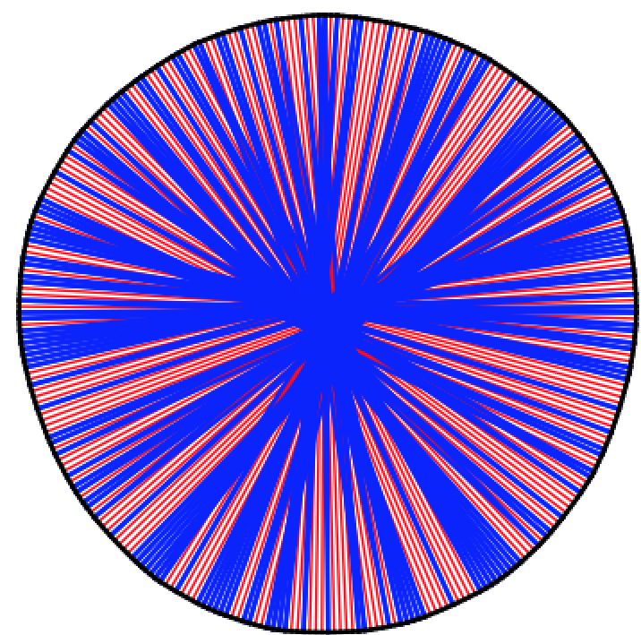
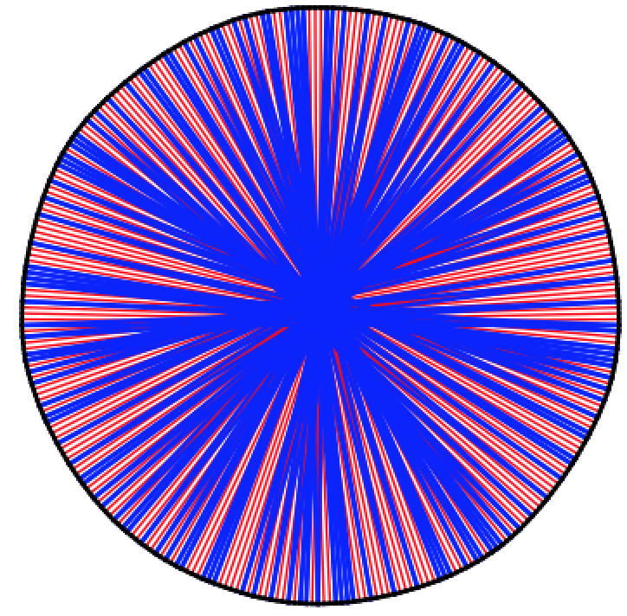
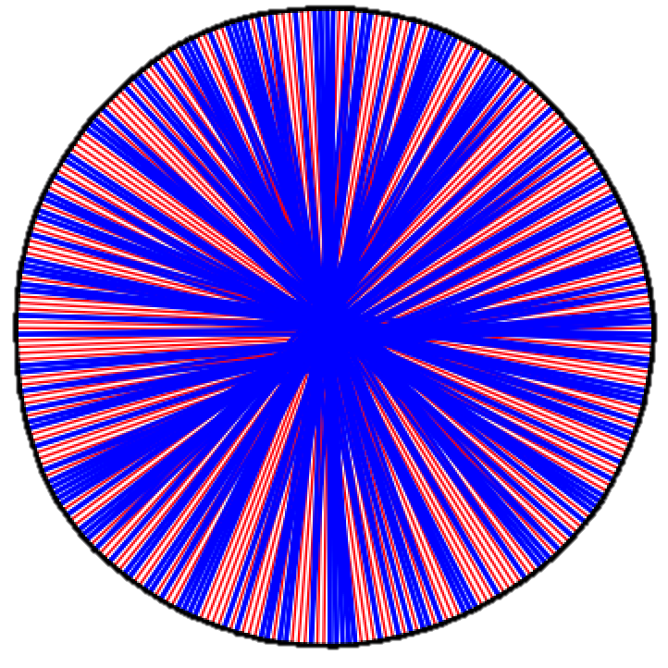
Computational Approach

Slide 31
Analysis of the Third Construction
The total number of Reinhardt polygons produced by the third construction is
If , i.e. , then the number of periodics produced is

Slide 32
Analysis (cont.)

Slide 33
Analysis (cont.)
If we let , i.e. in the previous equation, and , we obtain

Slide 34
Comparisons
For the second construction, the lower bound gives us approximately
The third construction gives us approximately

Slide 35
What’s Next?
Can we combine different compositions and obtain a better lower bound?
Can we find a formula for ?
Does the second/third construction give us all Reinhardt polygons?

Slide 36
FINDING SPORADIC 105-GONS

Slide 37
Relevant Challenges
Computational Limits
Current solution: restricting search space
Determining Uniqueness
Current solution: normalization

Slide 38
Previously Known Results
There are approximately 245 million periodic Reinhardt 105-gons
We believe there are over 350 million sporadic 105-gons
We can only determine around 60% of all sporadic Reinhardt 105-gons using the second construction

Slide 39
New Generation Methods
Enumerating all possible , , and is computationally impossible
This is on order of
Requires a new approach: if we can restrict one of , , or , then we can obtain a more attainable runtime

Slide 40
First Program
Example: if the coefficients of and sum to 2, then the coefficient of must be -1 to maintain the coefficient restrictions for
For , has degree 35, has degree 21, and has degree 15
We can cycle through all possibilities for and and then restrict the possible ’s
e.g.
… + − …
… + − …
… − + …
… + − …

Slide 41
Not Enough Restrictions
The previous technique is still exponential
But we can specify unique base cases and obtain some results
How else can we generate more sporadic 105-gons?

Slide 42
Adding Polynomials
Maintains divisibility by implicitly
Check for alternating, an odd number of nonzero terms, and

Slide 43
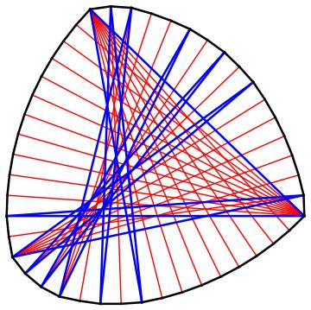
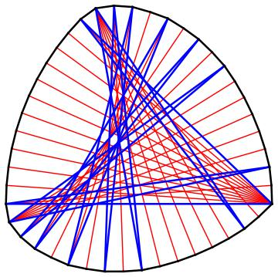
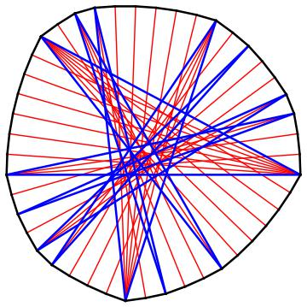
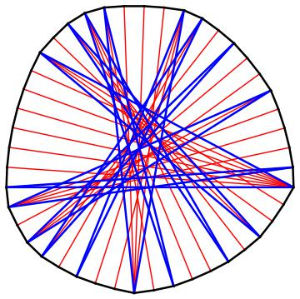
F1: [11, 9 , 1 , 2 , 1 , 2 , 3 , 1 , 2 , 1 , 2 , 1 , 6 , 2 , 1]
F2: [11, 2 , 1 , 6 , 1 , 2 , 1 , 2 , 2 , 2 , 2 , 1 , 2 , 1 , 6 , 1 , 2]
F3: [7, 6, 2, 3, 1, 2, 6, 4, 2, 1, 3, 2, 1, 2, 3]
F1 - F2 +F3: [7, 3 , 2 , 2 , 1 , 3 , 1 , 2 , 4 , 3 , 1 , 2 , 2 , 1 , 3 , 2 , 4 , 1 , 1]
-
+
=

Slide 44
Applications
We applied addition to two problems:
Determining a generating set for n = 45
Helps test the validity of the method
All n = 45 sporadic polygons are known
Finding previously unknown 105-gons

Slide 45
Generating Sets for n = 45
We found a generating set
Example: 20 sporadic polygons, the which generate the entire sporadic set,
144 sporadics
20

Slide 46
Adding to Obtain More 105-gons
Start by using the first program to generate a small set of 105-gons
Add the 105-gons together, combine the results and then iterate
The associated program is on order of

Slide 47
New Results for n = 105
We’ve been able to generate over 135,823 sporadic Reinhardt polygons
87,773 had not been previously determined by the second construction
35.4%
64.6%

Slide 48
What’s Next?
Maximizing computational power and obtaining adequate space management to find all sporadic Reinhardt 105-gons
Can we find a generating set for ?
What properties define elements in the generating set from others?

Slide 49
Acknowledgements
Michael Mossinghoff, Kevin Hare
Sinai Robins, Quang Nhat Le, Tarik Aougab
ICERM, Brown University

Slide 50
Questions?

